Slide 1
Operating system security
Andrei Petrovski
( a.petrovski@rgu.ac.uk)
CM530– System Programming and Security

Slide 2
Overview
Protection vs. Security in Operating Systems
Protection Mechanisms
Access Control Lists (ACLs)
Capability Lists (C-lists)
Operating System Hardening
Security Maintenance
Security Features of Main Operating Systems
Linux OS
Windows OS

Slide 3
Protection vs. Security
Protection is strictly an internal problem - protection mechanisms allow users to protect their resources and work well as long as the users do not try to circumvent the intended access to these resources. Security, on the other hand, requires not only an adequate protection system, but also consideration of the external environment within which the system operates. Thus, security is the measure of confidence that the integrity of the system and its data will be preserved.
Protection
Security goals met under trusted processes
Protects against an error by a non-malicious entity
Security
Security goals met under potentially malicious processes
Protects against any malicious entity

Slide 4
Protection
The role of protection in a computer system is to provide the mechanism for the enforcement of the policies governing resource use. These policies need to be separated from their implementation mechanisms.
A protection domain is a concept that specifies the resources that the process may access. Each domain defines a set of objects and the types of operations that may be invoked on each object. The ability to execute an operation on an object is called an access right.
The domain is a collection of access rights, each of which is an ordered pair <object-name, right-set>. For example, <file A, {read, write}>. Domains do not need to be disjoined; they may share access right.

Slide 5
Access Control
Subject. An entry capable of accessing objects. Generally, the concept of subjects equates with that of a process that represents a user or application.
Object. Anything to which access is controlled. Examples include files, programs, and segments of memory.
Access rights. The way in which an object is accessed by a subject (e.g. read, write, execute, print, switch).

Slide 6
Access control (cont.)
Access control is concerned with verifying the access rights of a given subject (aka principal, i.e. a user or application).
Whereas authorization is concerned with granting access rights.
Access control is based on the three pieces of information (principal, operation, resource). Here, it must decide if the given principal is allowed to carry out the given operation on the given resource.
Access control can be performed by using a reference monitor that intercepts all accesses to a resource, and checks the operation can be performed by the principal.

Slide 7
Implementation of Access Matrix
Global Table. This is the simplest implementation of the access matrix, and it is a set of ordered triples <subject, object, right-set>. The disadvantage of this method is that the table is usually large and cannot be kept in main memory.
Access Control Lists to Objects. The access matrix may be decomposed by columns, yielding access control lists. Thus, for each object, an access control lists specify subjects (usually users) and their permitted access rights.
Capability Lists for Subjects. The access matrix may be decomposed by rows to yield capability tickets, which specify authorised objects and operations for a given subject (user).
Lock-key Mechanism. This is a compromise between access lists and capability lists. Each object has a list of unique bit patterns, called locks. Similarly, each subject has a list of unique bit patterns, called keys. A process executing on behalf of a given subject has a key that matches one of the locks of the object.

Slide 8
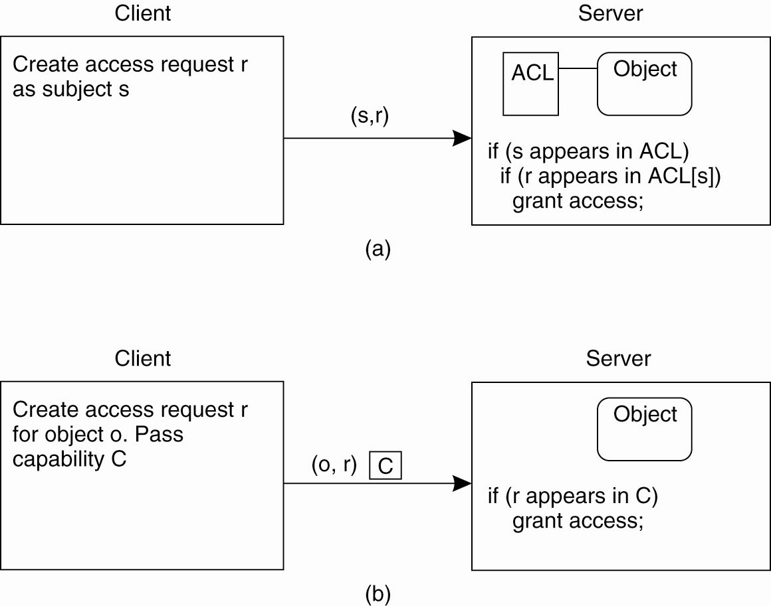
Protection of Objects
© Tanenbaum & Van Steen, 2007 Pearson Education, Inc.
a) Using an ACL
b) Using capabilities
8

Slide 9
Operating System Hardening
Installation: initial setup and patching
Removing unnecessary services, application and protocols
Configure users, group and authentication
access control
Configure resource control
permissions
additional controls (firewall, IDS/IPS)
Test the system security

Slide 10
Trusted Computer Base (TCB)
A Trusted Computer Base consists of the hardware and software necessary for enforcing all the security rules. If the TCB is working to specification, the system security cannot be compromised.
The TCB typically consists of most of the hardware (except I/O devices that do not affect security), a portion of the operating system kernel, and user programs that have superuser power.
An important part of the TCB is the reference monitor that accepts all system calls involving security and decides whether they should be processed. Therefore, the reference monitor allows all the security decisions to be put in one place, with no possibility of by-passing it.
Essential OS services :
process creation and switching,
memory management,
inter-process communication

Slide 11
Security Maintenance
Automated patching
Logging
Data Backup and Archive
Backup: making copies of data at regular intervals allowing recovery of lost or corrupted data
Archive: retaining copies of data over extended period of time in order to meet legal and operational requirements

Slide 12
Security Threat Monitoring
Statistical anomaly detection. This approach involves the collection of data relating to the behaviour of legitimate users over a period of time. Then statistical tests are applied to the observed behaviour.
Threshold detection. This approach defines thresholds for the frequencies of occurrences of various events (e.g. the number of incorrect passwords given);
Profile-based detection. A profile of each user is developed to detect changes in the behaviour.
Rule-based detection. This approach is based on an attempt to define a set of rules that can be used to decide that a given behaviour is that of an intruder.
Another common technique of threat monitoring is an audit log. An audit log simply records the time, user, and type of all accesses to an object. After security has been violated, the audit log can be used to determine how and when the problem occurred and what amount of damage was done.

Slide 13
OS Security case-studies

Slide 14

Linux Security
The Linux kernel provides a minimal set of security features, such as discretionally access control.
Authentication is performed outside the kernel by user-level applications such as login.
This simple security infrastructure has been designed to allow system administrators to:
redefine access control policies,
customise the way Linux authenticates users,
and specify encryption algorithms that protect system resources.

Slide 15
Linux Access Control
Under Linux, the setuid mechanism is augmented in two ways.
First, Linux implements the POSIX saved user-id mechanism, which allows a process to drop and re-acquire its effective UID repeatedly.
For security reasons, a program may want to perform most of its operations in a safe mode, waiving the privileges granted by its setuid status; at the same time, some operations need to be performed with all the privileges. Saved UIDs allow a process to set its effective UID to its real UID and then back to its previous value without having to modify the real UID at any time.
The second enhancement provided by Linux is the addition of a process characteristic that grants only a subset of the rights of the effective UID.
The fsuid and fsgid process properties are used when access rights are granted to files. The appropriate property is set every time the effective UID and GID is set. However, the fsuid and fsgid can be set independently of the effective IDs, allowing a process to access files on behalf of another user without taking on the identity of that user.

Slide 16
Pluggable Authentication Modules (PAM)
Most Linux systems have PAMs in the form of pre-compiled packages accessible from the relevant repository.
e. g. an authentication token on the basis of a USB storage device:
$sudo apt-get install pamusb-tools libpam-usb
Configure corresponding devices through editing system files:
/etc/pamusb.conf
Use system monitoring facilities to check authentication:
acct package

Slide 17
Linux Vulnerabilities
Network-facing daemons
Rootkits via kernel modules
Environmental variables
i.e. system variables that are available to processes to convey state across applications. One such variable is LIBPATH, whose value determines the search order for dynamic libraries. A common vulnerability is that an attacker can change LIBPATH to load an attacker-provided file as a dynamic library.
Since environment variables are inherited when a child process is created, an untrusted process can invoke a TCB program under an untrusted environment .
Furthermore, TCB programs may be vulnerable to any input value supplied by an untrusted process, e.g. a configuration file typically describes all the other places that the program should look for inputs to describe how it should function, sometimes including the location of libraries that it should use and the location of hosts that provide network information. If the attacker can control the choice of a program’s configuration file, s/he often has a variety of ways to compromise the running process.
Shared resources
Time-of-Check-to-Time-of-Use

Slide 18

Windows OS Security
Windows OS governs access control by two entities: an access token associated with each process and a security descriptor associated with each object for which inter-process access is possible.
The access token serves two purposes:
It keeps all necessary security information together to speed access validation.
It allows each process to modify its security characteristics in limited ways without affecting other processes running on behalf of the user.
Associated with each object for which inter-process access is possible is a security descriptor. The chief component of the security descriptor is an access control list (ACL) that specifies access rights for various users and user groups for this object.
An important feature of Windows OS security is that applications can make use of the security framework for user-defined objects.

Slide 19
Facilities of Windows OS Security System
A mandatory logon procedure with passwords for all users.
Access control: owners of system resources (e.g. files) can grant or revoke access rights to other users or groups.
Audit control: security sensitive operations (e.g. assigning a new user or accessing system files) should be logged and reported to a system administrator.
Memory protection: memory freed by a process must be initialised before its re-allocation to a new process. In the absence of this service, a program using an area of un-initialised variable data could retrieve information left behind by another process.

Slide 20
Windows OS User Authentication
Windows 7 contains a comprehensive user authentication mechanism ranging from very simple (the default option) to very rigorous authentication.
Two main components of the authentication mechanism are the local security authority subsystem (LSAS) and the security reference monitor (SRM). The LSAS is a user space program that in addition to some other duties manages user authentication. The SRM is part of the OS kernel that sets up access rights to these objects.
These two systems are assisted by security accounts manager (SAM) server, active directory server, and the Winlogon process.
Once Winlogon obtains the user information, it tries to authenticate the user by one of the authentication algorithms – the defaults are the Microsoft local authentication (MLA) or the Kerberos mechanism.
During user authentication, the LSAS requests the SRM to create a user’s access token. This token is created for the user after the authentication procedure has been completed successfully. The function of the token is to act as a key that will be used by all threads and processes created by the user logon.

Slide 21
Windows Vulnerabilities
The Windows Registry
The Windows Registry is a global, hierarchical database to store data for all programs. When a new application is loaded it may update the registry with application-specific data, such as security-sensitive information containing the paths to libraries and executables to be loaded for the application.
While each registry entry can be associated with a security context that limits access, such limitations are generally not effectively used, as vendors have to ensure that their software will execute when it is downloaded.
Administrator Users
Enabled by default deployment of OS

